Slide 1






Presenters
Analysis on
Union Budget 2021-2022
ON EDUCATIONAL SECTOR.
Presenters:
Lagusudhakar. P
Sanjuna. R
Pooja. A
ASBM – Experience The Corporate Life

Slide 2


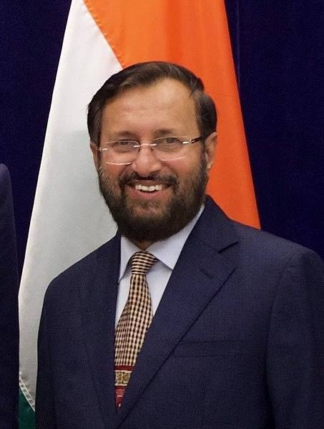
Sector Name:EDUCATION
Federal Minister :
RAMESH POKHRIYAL
An Indian politician
began his political career in 1980’s
who was appointed
on 31 May 2019 to serve as
Minister of Human Resource Development

Slide 3
Sector Name : EDUCATION
RAMESH POKHRIYAL
Born : 15 July 1959 (age 61 years), Pauri Garhwal
Education : HEMVATI NANDAN BAHUGUNA GARHWAL UNIVERSITY
Party : Bharathiya Janata Party

Slide 4
Sector Name : EDUCATION
Federal Minister : RAMESH POKHRIYAL
Ministry of Education
Member of : Union Cabinet
Reports to : Prime Minister of India
Appointer : President of India on the
advice of the PM
Formation : 15 August 1947

Slide 5
Current Budget 2021-22 Highlights
Rs 93,223 crore for education sector in 2021
The Department of School Education has been allocated Rs. 54, 873 crore
The allocation for the Department of Higher Education is Rs. 38, 350 crore

Slide 6
Current Budget 2021-22 Highlights
Skill development is an important highlight of Union Education Budget 2021-22.
15,000 schools to be strengthened by implementing all NEP components.
Unit cost of each school to be increased to Rs 38 crore

Slide 7
Current Budget 2021-22 Highlights
Schools will see greater consolidation and quality upgrade under the Rs 4,684 crore Adarsh Vidyalaya scheme.
Rs 3000 crore for realignment of existing National Apprenticeship Training Scheme (NATS) towards post-education apprenticeship, training of graduates and diploma holders in Engineering

Slide 8
Budget Comparison 2020 / 2021
The allocation for the education ministry has been cut to Rs 93,223 crore from Rs 99,311 crore, as per the budgetary proposals.
Department of School Education has been allocated Rs 54,873 crore, down from Rs 59,845 crore in the previous budget.
Department of Higher Education has gone down to Rs 38,350 crore from Rs 39,466 crore

Slide 9
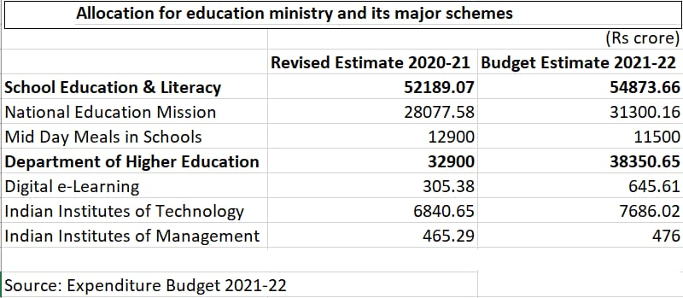
Budget Comparison 2020 / 2021

Slide 10
New Insights and Futuristic Plans 2021-22
100 new Sainik schools will be set up with partnership with NGOs, private schools and states.
Under Education Budget 2021, government will establish 750 Ekalavya residential schools in the Tribal Areas.
50,000 crore will be allocated over the next five years for the National Research Foundation.

Slide 11
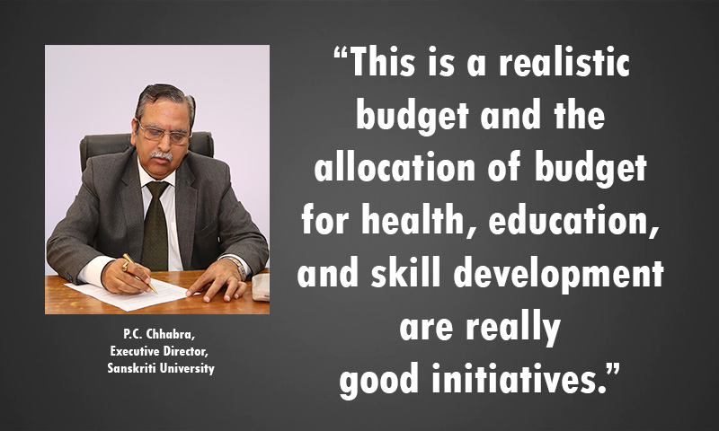
Sector Specific Expert’s Views on 2021-22 Budget
P.C. Chhabra, Executive Director, Sanskriti University

Slide 12

Sector Specific Expert’s Views on 2021-22 Budget
Prof. DAVIENDRA NARANG ,DIRECTOR, JAIPURIA INSTITUTE OF MANAGEMENT GHAZIABAD

Slide 13
Summary and Conclusion
SUMMARY
The budget on Education mainly focuses on implementation of National Education Policy, International Research Collaborations and setting up of a Commission for Higher Education.

Slide 14
Summary and Conclusion
CONCLUSION
A key portion of India’s population consists of kids and young people. There is abundance of human resources available which can prove very beneficial for the development of the country.
Thus, investing more on such wealth on such useful resources can only yield great results in the long run. And the best way to mould the young population in the right way is to provide good quality education which is focused on practical knowledge and skills.

